Slide 1

Graphs Part 1
CISC 3220 Lecture 9
By Ariel Avshalom

Slide 2
What is a graph?
A graph is a collection of edges and vertices
Each edge connects two vertices
Let’s look at one on OneNote now:

Slide 3
Different drawings of the same graph
Graphs can be drawn differently, but still be equivalent to one another:

Slide 4
Graph isomorphism
Two graphs are isomorphic if there is a one-to-one correspondence between their vertices
The number of edges joining any two vertices is equal to the number of edges joining the corresponding vertices

Slide 5
Check out some famous graph problems
The seven brides of Konigsberg
The traveling salesperson problem
The 4-color map problem
Here are other good videos on the 4-color problem

Slide 6
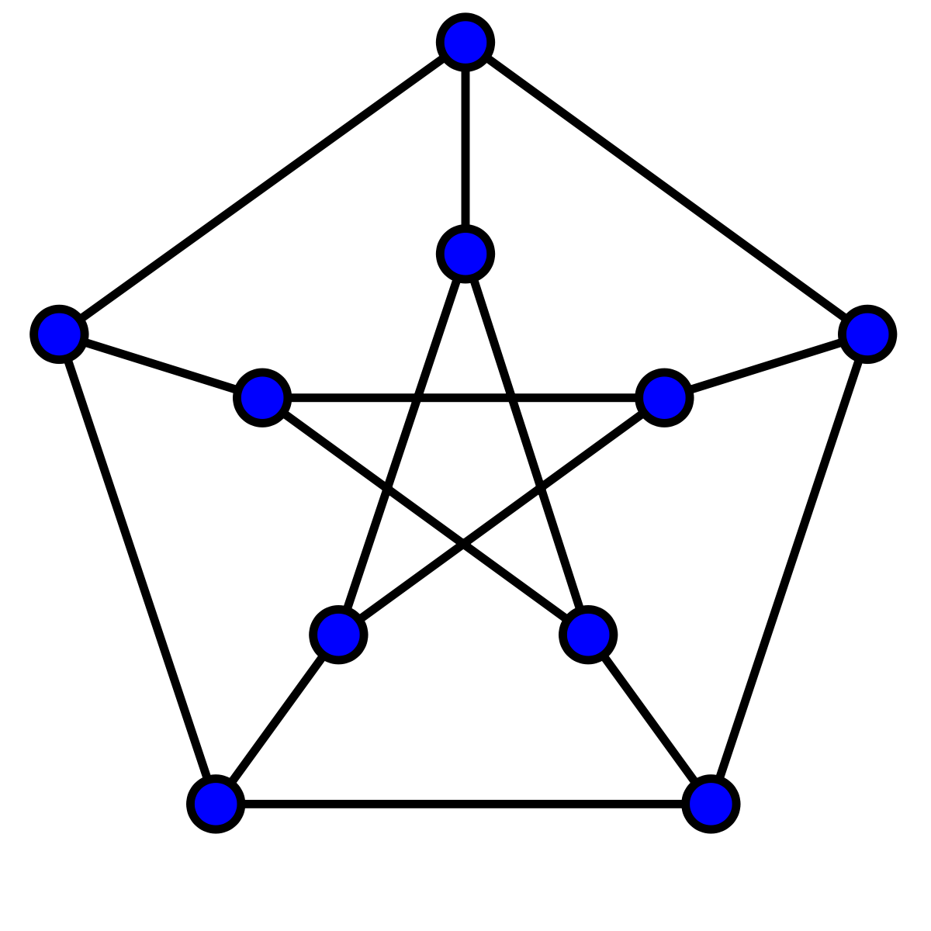
Petersen Graph
This graph is
Undirected
Contains 10 vertices
Contains 15 edges
Is 3-connected
Has a diameter of 2
Is famous enough to have a wiki article

Slide 7
Online graph editor and starter guide
Check out this graph editor by a former CUNY student
We will go over this brief introduction graph theory now
Check out D3’s graph theory tool

